Slide 1
New York State Prison Admissions Exploratory Data Analysis
2008 – 2018
Richard Choi

Slide 2
Agenda

Slide 3
Introduction
According to this study by the Bureau of Justice Statistics the United States has a prison population of 2.2 million people.
As this number is staggering, I wanted to get a sense of what that may look like closer to home
The State of New York compiled a data set pertaining to prison admissions from 2008 to 2018 containing info relating to the following:
year, month and year of admission, county, gender, crime, age
For the sake of simplicity, a few assumptions were made about data:
Prisoners were grouped into different age groups
Crimes were grouped into more general levels (i.e. drug related vs drug possession or drug selling
Data: https://www.kaggle.com/new-york-state/nys-prison-admissions-beginning-2008
Shiny App: https://richardcchoi.shinyapps.io/prison/

Slide 4
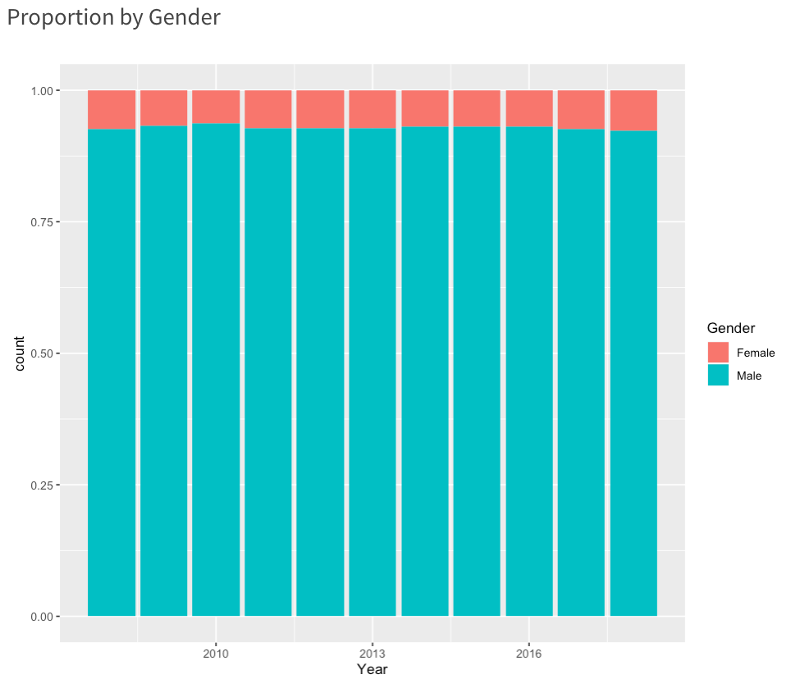
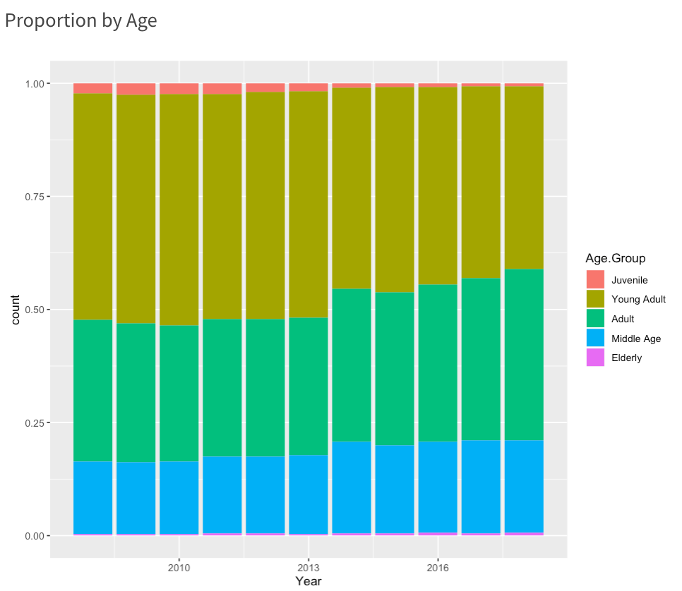
Demographic Analysis

Slide 5
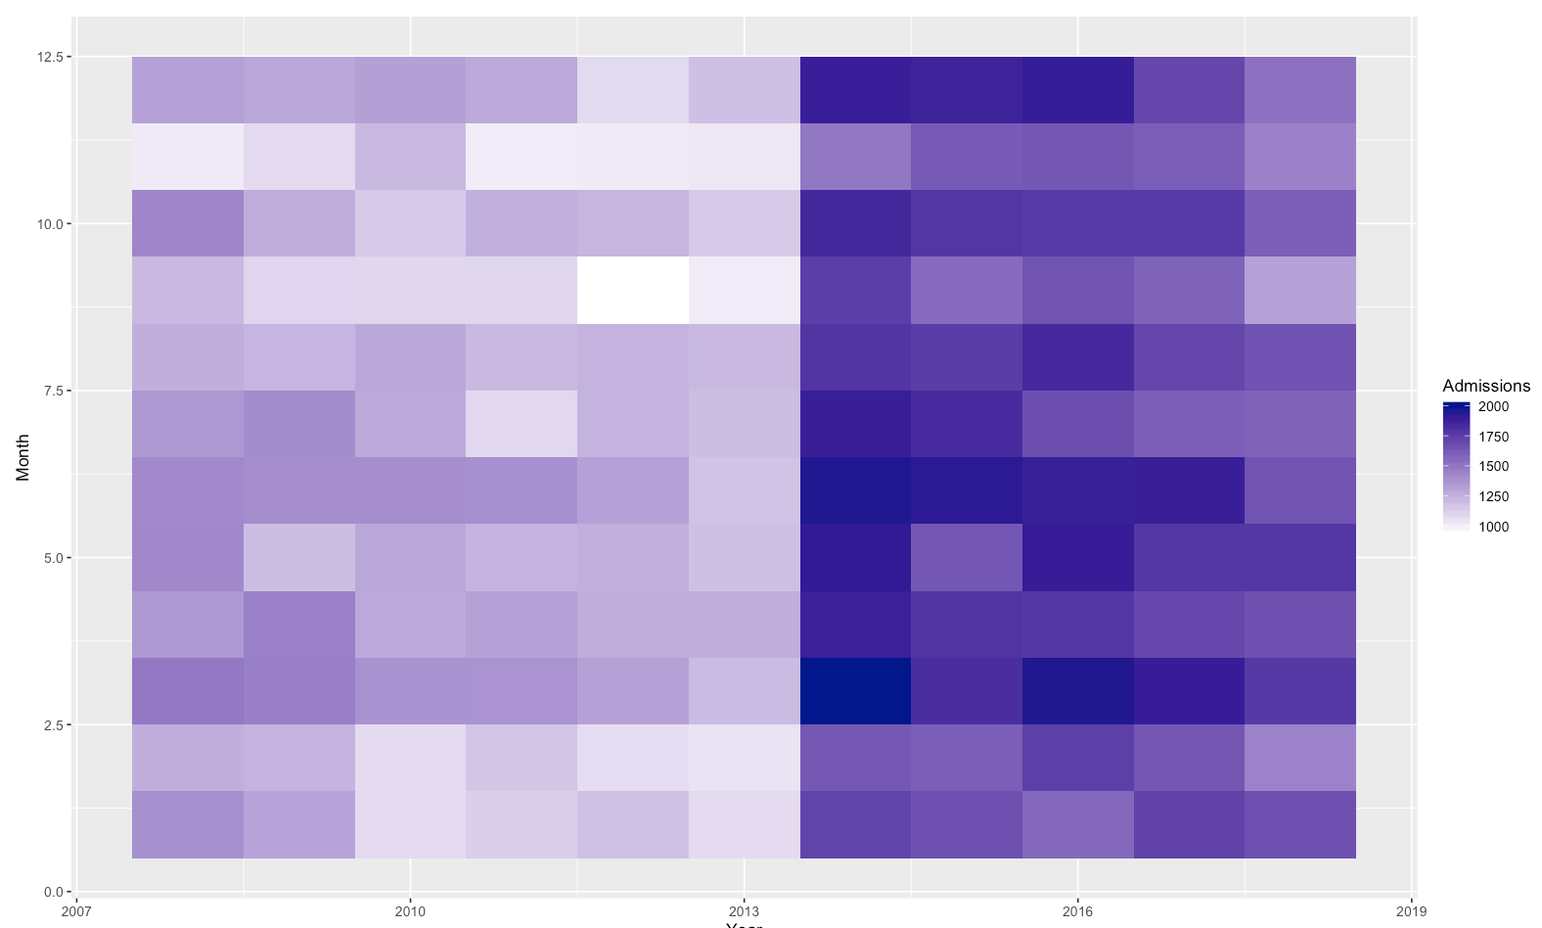
Trend Analysis

Slide 6
Top Crime

Slide 7
Top Crime (continued)

Slide 8
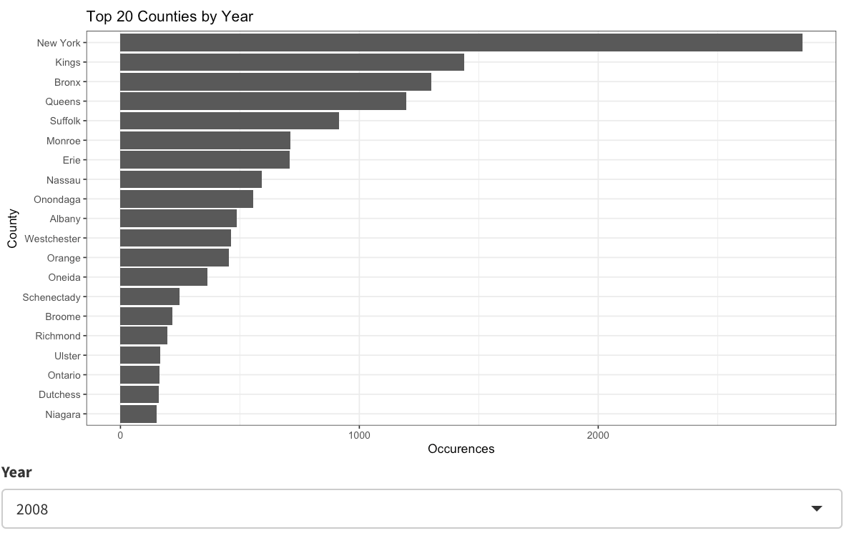
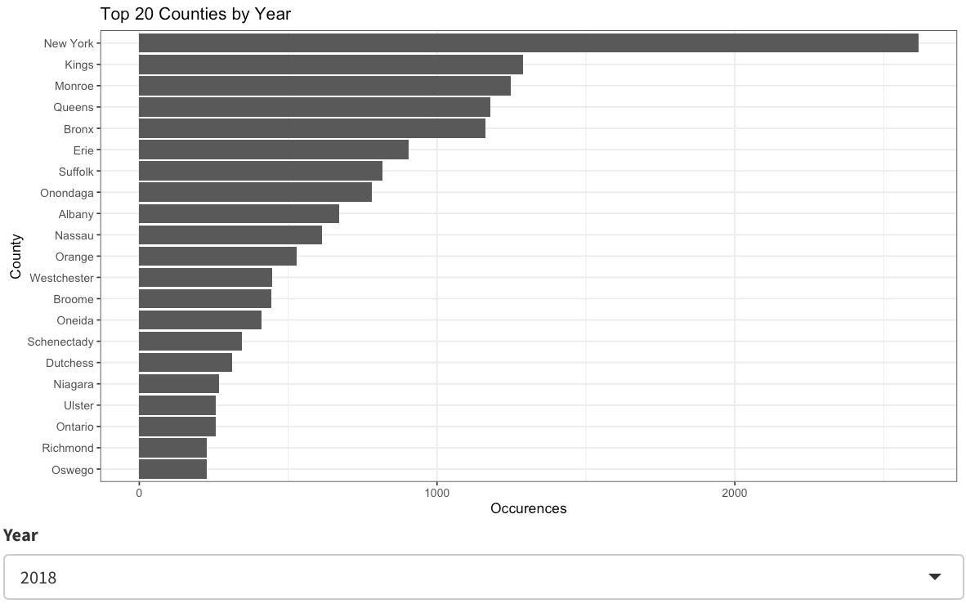
County Analysis

